Slide 1
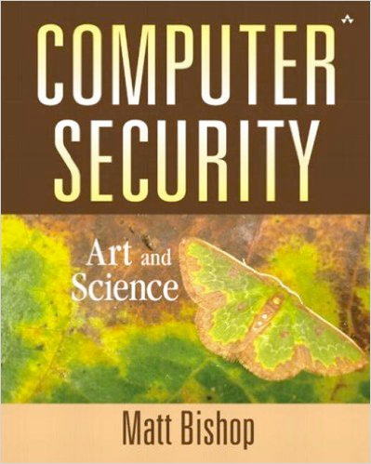
Computer and Network Security COMP 5370/637* Lecture #7 August 31, 2015
Tony Skjellum
skjellum@auburn.edu

Slide 2
Today’s Topics
Classic Cryptography
Cæsar cipher
Vigènere cipher
DES
Public Key Cryptography
Diffie-Hellman
RSA
Cryptographic Checksums
HMAC

Slide 3
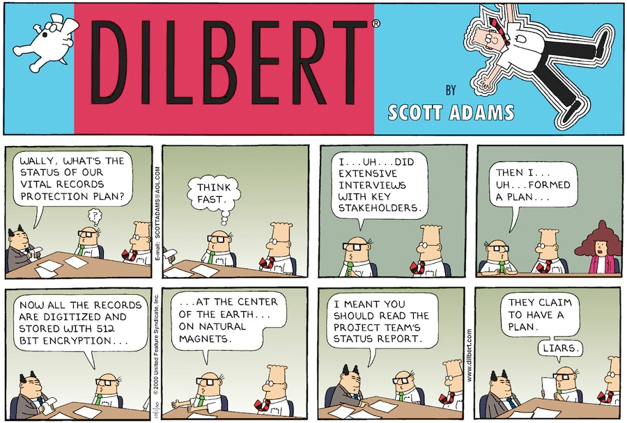
More Dilbert Security!
http://dilbert.com/search_results?terms=cyber+security

Slide 4
Cryptosystem
Quintuple (E, D, M, K, C)
M set of plaintexts
K set of keys
C set of ciphertexts
E set of encryption functions e: M ⋅ K → C
D set of decryption functions d: C ⋅ K → M

Slide 5
Example
Example: Cæsar cipher
M = { sequences of letters }
K = { i | i is an integer and 0 ≤ i ≤ 25 }
E = { E_{k} | k ∈ K and for all letters m,
E_{k}(m) = (m + k) mod 26 }
D = { D_{k} | k ∈ K and for all letters c,
D_{k}(c) = (26 + c – k) mod 26 }
C = M

Slide 6
Attacks
Opponent whose goal is to break cryptosystem is the adversary
Assume adversary knows algorithm used, but not key
Three types of attacks:
ciphertext only: adversary has only ciphertext; goal is to find plaintext, possibly key
known plaintext: adversary has ciphertext, corresponding plaintext; goal is to find key
chosen plaintext: adversary may supply plaintexts and obtain corresponding ciphertext; goal is to find key

Slide 7
Basis for Attacks
Mathematical attacks
Based on analysis of underlying mathematics
Statistical attacks
Make assumptions about the distribution of letters, pairs of letters (digrams), triplets of letters (trigrams), etc.
Examine ciphertext, correlate properties with the assumptions.

Slide 8
Classical Cryptography
Sender, receiver share common key
Keys may be the same, or trivial to derive from one another
Sometimes called symmetric cryptography
Two basic types
Transposition ciphers
Substitution ciphers
Combinations are called product ciphers

Slide 9
Transposition Cipher
Rearrange letters in plaintext to produce ciphertext
Example (Rail-Fence Cipher)
Plaintext is HELLO WORLD
Rewrite characters in successive rows, top to bottom, one character per row (hence rail fence)
HLOOL
ELWRD
Ciphertext is HLOOL ELWRD

Slide 10
Attacking the Cipher
Anagramming
Consider "gram-ness"
1-gram = frequency of individual letters in a vocabulary
2-gram = frequency of letter pairs in a vocabulary
n-gram = frequency of n-letter sequences
If 1-gram frequencies match English frequencies, but other n-gram frequencies do not, probably transposition
Rearrange letters to form n-grams with highest frequencies
Given
C = HLOOLELWRD
2-gram analysis
freq("HE") = .0305
freq("HO") = .0043
freq("Hx") < .0010
freq("Ex") < .0002
so, "HE" is probable juxtaposition
Make "HE" an "anchor point", write letters in rows below or above:
HE
LL
OW
OR
LD

Slide 11
Substitution Ciphers
Change characters in plaintext to produce ciphertext
Example (Cæsar cipher)
Plaintext is HELLO WORLD
If key=3, change each letter to the third letter following it
A becomes D
B becomes E
X becomes A
Z becomes C, etc.
Ciphertext is KHOOR ZRUOG

Slide 12
Attacking the Cipher
Exhaustive search
If the key space is small enough, try all possible keys until you find the right one
Cæsar cipher has 26 possible keys
Statistical analysis
try key and compare result to 1-gram model of English

Slide 13
Example Statistical Attack
Compute frequency of each letter in ciphertext:
Given KHOOR ZRUOG,
Frequencies of individual letters are:
G 0.1 H 0.1 K 0.1 O 0.3
R 0.2 U 0.1 Z 0.1

Slide 14
1-Gram Character Frequencies
a | 0.080 | h | 0.060 | n | 0.070 | t | 0.090
b | 0.015 | i | 0.065 | o | 0.080 | u | 0.030
c | 0.030 | j | 0.005 | p | 0.020 | v | 0.010
d | 0.040 | k | 0.005 | q | 0.002 | w | 0.015
e | 0.130 | l | 0.035 | r | 0.065 | x | 0.005
f | 0.020 | m | 0.030 | s | 0.060 | y | 0.020
g | 0.015 |  |  |  |  | z | 0.002

Slide 15
Statistical Analysis
f(c) frequency of character c in ciphertext
ϕ(i) correlation of frequency of letters in ciphertext with corresponding letters in English, assuming key is i
ϕ(i) = Σ_{0 ≤ c ≤ 25} f(c)p(c – i), where
p(x) is the frequency of x in English
for "KHOOR ZRUOG" -> G H K O R U Z
ϕ(i) = 0.1p(6 – i) + 0.1p(7 – i) + 0.1p(10 – i) + 0.3p(14 – i) + 0.2p(17 – i) + 0.1p(20 – i) + 0.1p(25 – i)
…

Slide 16
Correlation: ϕ(i) for 0 ≤ i ≤ 25
i | ϕ(i) | i | ϕ(i) | i | ϕ(i) | i | ϕ(i)
0 | 0.0482 | 7 | 0.0442 | 13 | 0.0520 | 19 | 0.0315
1 | 0.0364 | 8 | 0.0202 | 14 | 0.0535 | 20 | 0.0302
2 | 0.0410 | 9 | 0.0267 | 15 | 0.0226 | 21 | 0.0517
3 | 0.0575 | 10 | 0.0635 | 16 | 0.0322 | 22 | 0.0380
4 | 0.0252 | 11 | 0.0262 | 17 | 0.0392 | 23 | 0.0370
5 | 0.0190 | 12 | 0.0325 | 18 | 0.0299 | 24 | 0.0316
6 | 0.0660 |  |  |  |  | 25 | 0.0430

Slide 17
The Result
Most probable keys, based on ϕ:
i = 6, ϕ(i) = 0.0660
plaintext EBIIL TLOLA
i = 10, ϕ(i) = 0.0635
plaintext AXEEH PHKEW
i = 3, ϕ(i) = 0.0575
plaintext HELLO WORLD
i = 14, ϕ(i) = 0.0535
plaintext WTAAD LDGAS
Only English phrase is for i = 3
so, key = 3

Slide 18
Weakness
If key is too short
Can be found by exhaustive search
Statistical frequencies not concealed well
Solution: make it longer
Multiple letters in key
Idea is to smooth the statistical frequencies to make cryptanalysis harder

Slide 19
Vigènere Cipher
Like Cæsar cipher, but with a phrase
Example
Message THE BOY HAS THE BALL
Key VIG
Encipher using Cæsar cipher for each letter:
key VIGVIGVIGVIGVIGV
plain THEBOYHASTHEBALL
cipher OPKWWECIYOPKWIRG
V is 21
T is 19
(19+21)mod26 = 14
O is 14

Slide 20
Useful Terms
period: length of a key
Key "VIG" has period = 3
tableau: table used to encipher and decipher
Vigènere cipher has key letters on top, plaintext letters on the left
polyalphabetic: a key that has several different letters
Cæsar cipher is monoalphabetic

Slide 21
Relevant Parts of Tableau
Key Letters
G I V
A G I V
B H J W
E L M Z
H N P C
L R T G
O U W J
S Y A N
T Z B O
Y E H T
Note: only relevant rows, columns shown
Example encipherments:
key V, letter T: follow V column down to T row (giving “O”)
Key I, letter H: follow I column down to H row (giving “P”)
Plain Text Letters

Slide 22
Attacking the Cipher
Approach
Establish period; call it n
Break message into n parts, each part being enciphered using the same key letter
Solve each part
You can leverage one part from another

Slide 23
One-Time Pad
A Vigenère cipher with a random key at least as long as the message
Provably unbreakable
Plaintext + random value = random value, thus presenting no statistical patterns
Warning: keys must be random, or you can attack the cipher by trying to regenerate the key
Approximations, such as using pseudorandom number generators to generate keys, are not random

Slide 24
VENONA, 1
Codename used for the U.S. Signals Intelligence effort to collect and decrypt the text of Soviet messages from 1942-46.
The Soviet company that manufactured the one-time pads produced around 35,000 pages of duplicate key numbers
Duplicates discovered, but not removed.
Mitigation was to distribute duplicates as widely as possible
http://en.wikipedia.org/wiki/Venona_project
Notes:
NSA link has moved to http://www.nsa.gov/public_info/declass/venona/
All of the VENONA translations have been made public

Slide 25
VENONA,2
But, patterns appeared, yielding to cryptographic analysis
Agonizingly slow and difficult process which yielded one or two words
1942 1.8% ← duplicate keys produced
1943 15.0%
1944 49.0%
1945 1.5% ← duplicate keys exhausted
http://en.wikipedia.org/wiki/Venona_project
Notes:
NSA link has moved to http://www.nsa.gov/public_info/declass/venona/
All of the VENONA translations have been made public

Slide 26
VENONA,3
These messages provided extraordinary insight into Soviet attempts to infiltrate the highest levels of the United States Government.
In 1953, a photocopy of a partially burned codebook (recovered by U.S. Military Intelligence in 1945) was discovered to be related to the VENONA cryptographic systems. This confirmed decrypted information.
Now … on to more sophisticated schemes
http://en.wikipedia.org/wiki/Venona_project
Notes:
NSA link has moved to http://www.nsa.gov/public_info/declass/venona/
All of the VENONA translations have been made public

Slide 27
Product Ciphers
Recall: two basic types
Transposition ciphers
Substitution ciphers
Combining the two results in a product cipher
Modern product ciphers operate on blocks instead of individual characters

Slide 28
Feistel Cipher Structure
Virtually all conventional block encryption algorithms have a structure first described by Horst Feistel of IBM in 1973.
Feistel parameters:
Block size: larger block sizes mean greater security
Key Size: larger key size means greater security
Number of rounds: multiple rounds offer increasing security
Subkey generation: greater complexity will lead to greater difficulty of cryptanalysis.
Speed: the rate at which information is encrypted/decrypted is of concern
Notes:
Additional content from text:
Classical (symmetric) cryptosystems:
Transposition ciphers – rearranges characters from the plaintext in the ciphertext. The letters are not changed.
Vulnerable to 1-gram attacks since characters are unchanged. A 1-gram attack uses a model of the language to analyze character frequencies and compare them to that of the ciphertext.
Substitution ciphers – characters in plaintext are changed to produce cipher text.
Caesar Cipher – Each character is implemented by a constant amount, wrapping around the alphabet. Susceptible to a statistical ciphertext-only attack using a model of the language.
Vignere Cipher – chooses a sequence of keys, represented by a string. The keys are used in a lookup table to encrypt the text. Also vulnerable to statistical ciphertext-only attacks.
One-time pad is a variant, where the key is chosen at random.
Feistel Cipher structure is used to construct block ciphers. Block ciphers encipher and decipher multiple bits at once, rather than one bit at a time. Feistel ciphers rely on multiple rounds of similar operations on data. Operations include bit-shuffling (P-boxes), simple non-linear functions (P-boxes), and linear mixing (XOR). [http://simple.wikipedia.org/wiki/Feistel_cipher]

Slide 29
Average time required for exhaustive key search
Key Size (bits) | Number of Alternative Keys | Time required at 10⁶ Decryption/µs
32 | 2³² = 4.3 x 10⁹ | 2.15 milliseconds
56 | 2⁵⁶ = 7.2 x 10¹⁶ | 10 hours
128 | 2¹²⁸ = 3.4 x 10³⁸ | 5.4 x 10¹⁸ years
168 | 2¹⁶⁸ = 3.7 x 10⁵⁰ | 5.9 x 10³⁰ years
Approximate age of the Universe in seconds: 4.32 × 10^17 =~ 13,689,546,313 years
Notes:
Larger keys make the algorithm less vulnerable to brute force attacks, but also increase the time needed for encryption.

Slide 30
DES, 1
Data Encryption Standard (DES)
Widely used encryption scheme
The algorithm referred to is the Data Encryption Algorithm (DEA)
DES is a block cipher
The plaintext is processed in 64-bit blocks
The key is 56-bits in length
8-bits for parity; 16 rounds, each use 48-bit key
Notes:
DES is also a symmetrical block cipher. Key is 56 bits because 8 bits are for parity. Consists of 16 rounds, each using a 48-bit key.

Slide 31
DES, 2
A note from Stallings on DEA, DES, TDEA and 3DES:
The terminology is a bit confusing. Until recently, the terms DES and DEA could be used interchangeably. However, the most recent edition of the DES document includes a specification of the DEA described here plus the triple DEA (TDEA). Both DEA and TDEA are part of the data encryption standard. Further, until the recent adoption of the official term TDEA, the triple DEA algorithm was typically referred to as triple DES and written as 3DES.
Stallings, W. Cryptography and Network Security: Principles and Practice, 2nd edition. Prentice Hall, 1999
Notes:
DES is also a symmetrical block cipher. Key is 56 bits because 8 bits are for parity. Consists of 16 rounds, each using a 48-bit key.

Slide 32
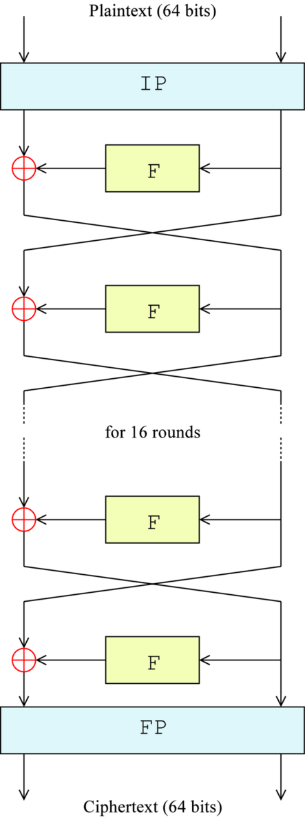
DES Overview, 1
16 identical stages of processing, termed rounds.
Initial and final permutation (IP and FP) which are inverses
Initially, block is divided into two 32-bit halves and processed alternately
Criss-crossing is known as the Feistel scheme.
Ensures that decryption and encryption are very similar processes
No need for separate encryption and decryption algorithms.
http://en.wikipedia.org/wiki/Data_Encryption_Standard
Notes:
The algorithm's overall structure is shown in Figure 1: there are 16 identical stages of processing, termed rounds. There is also an initial and final permutation, termed IP and FP, which are inverses (IP "undoes" the action of FP, and vice versa). IP and FP have no cryptographic significance, but were included in order to facilitate loading blocks in and out of mid-1970s 8-bit based hardware.[21]
Before the main rounds, the block is divided into two 32-bit halves and processed alternately; this criss-crossing is known as the Feistel scheme. The Feistel structure ensures that decryption and encryption are very similar processes — the only difference is that the subkeys are applied in the reverse order when decrypting. The rest of the algorithm is identical. This greatly simplifies implementation, particularly in hardware, as there is no need for separate encryption and decryption algorithms.
The ⊕ symbol denotes the exclusive-OR (XOR) operation. The F-function scrambles half a block together with some of the key. The output from the F-function is then combined with the other half of the block, and the halves are swapped before the next round. After the final round, the halves are swapped; this is a feature of the Feistel structure which makes encryption and decryption similar processes.

Slide 33
DES Overview, 2
F-function scrambles half a block together with some of the key.
Output of F-function is XOR'ed with the other half of the block, and the halves are swapped before the next round.
After the final round, the halves are swapped
Done to make encryption and decryption processes similar
http://en.wikipedia.org/wiki/Data_Encryption_Standard
Notes:
The algorithm's overall structure is shown in Figure 1: there are 16 identical stages of processing, termed rounds. There is also an initial and final permutation, termed IP and FP, which are inverses (IP "undoes" the action of FP, and vice versa). IP and FP have no cryptographic significance, but were included in order to facilitate loading blocks in and out of mid-1970s 8-bit based hardware.[21]
Before the main rounds, the block is divided into two 32-bit halves and processed alternately; this criss-crossing is known as the Feistel scheme. The Feistel structure ensures that decryption and encryption are very similar processes — the only difference is that the subkeys are applied in the reverse order when decrypting. The rest of the algorithm is identical. This greatly simplifies implementation, particularly in hardware, as there is no need for separate encryption and decryption algorithms.
The ⊕ symbol denotes the exclusive-OR (XOR) operation. The F-function scrambles half a block together with some of the key. The output from the F-function is then combined with the other half of the block, and the halves are swapped before the next round. After the final round, the halves are swapped; this is a feature of the Feistel structure which makes encryption and decryption similar processes.

Slide 34
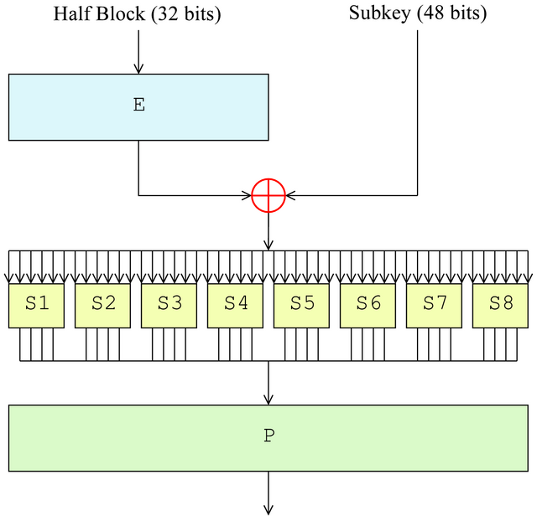
Feistel Function
http://en.wikipedia.org/wiki/Data_Encryption_Standard

Slide 35
Feistel Function,2
Expansion
the 32-bit half-block is expanded to 48 bits by duplicating half of the bits.
The output consists of eight 6-bit (8 * 6 = 48 bits) pieces
each contains a copy of 4 corresponding input bits, plus a copy of the immediately adjacent bit from each of the input pieces to either side.
Key mixing
Expansion is XOR'ed with a subkey using an XOR operation.
http://en.wikipedia.org/wiki/Data_Encryption_Standard

Slide 36
Feistel Function,3
Substitution
The block is divided into eight 6-bit pieces.
Each 6-bit piece is processed by an S-box (substitution boxes)
S-boxes replace six input bits with four output bits according to a non-linear transformation, provided in the form of a lookup table.
The S-boxes provide the core of the security of DES — without them, the cipher would be linear, and trivially breakable.
Permutation
Outputs from the S-boxes are rearranged according to a fixed permutation, the P-box.
Done to spread across different S boxes in the next round.
http://en.wikipedia.org/wiki/Data_Encryption_Standard

Slide 37
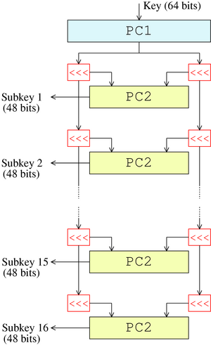
Subkeys, 1
56 bits of the key are selected from the initial 64 (PC1)
remaining eight bits are either discarded or used as parity check bits.
56 bits are then divided into two 28-bit halves
each half is thereafter treated separately.
both halves are rotated left in successive rounds.
done to ensure different sets of bits are used in each subkey
48 subkey bits are selected (PC2)
24 bits from the left half, and 24 from the right.
http://en.wikipedia.org/wiki/Data_Encryption_Standard

Slide 38
Subkeys, 2
Decryption is similar
subkeys are in reverse order compared to encryption.
http://en.wikipedia.org/wiki/Data_Encryption_Standard

Slide 39
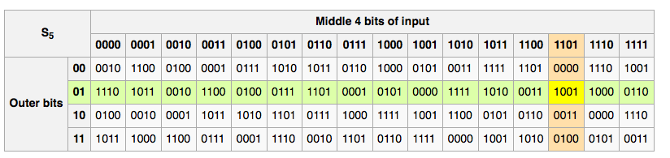
S-box (DES has 8 of these)
Substitution box
Basic component of symmetric cryptography
In block ciphers, used to obscure relationship of key and ciphertext
6-bit input, 4-bit output
https://en.wikipedia.org/wiki/S-box

Slide 40
Controversy
Complementation property
DES_{k}(m) = c ⇒ DES_{k′}(m′) = c′
where k', m', and c' are the complements of k, m, and c
S-boxes exhibit irregular properties
Distribution of odd, even numbers non-random
Outputs of fourth box depends on input to third box

Slide 41
Controversy
Considered too weak
Diffie, Hellman said in a few years technology would allow DES to be broken in days
Design using 1999 technology published
Design decisions not public [until much later]
S-boxes may have backdoors
The S-box design criteria were eventually published (in Coppersmith 1994) after the public rediscovery of differential cryptanalysis, showing that they had been carefully tuned to increase resistance against this specific attack.
Biham and Shamir found that even small modifications to an S-box could significantly weaken DES.

Slide 42
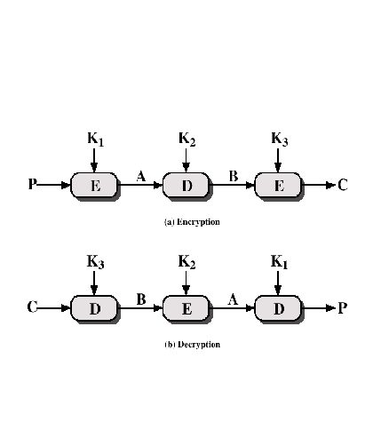
Triple DES
Use three keys and three executions of the DES algorithm (encrypt-decrypt-encrypt)
C = ciphertext
P = Plaintext
EK[X] = encryption of X using key K
DK[Y] = decryption of Y using key K
Effective key length of 168 bits
C = EK3[DK2[EK1[P]]]
Notes:
Triple DEA effectively solves the problem of the short key by using three keys, effectively increasing key length to 128 bits.
RFC 3217 specifies a process for wrapping one triple DEA key in another. This is used to protect keys from exposure.

Slide 43
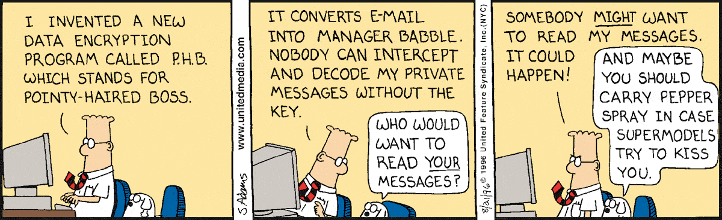
Final thoughts for today
http://dilbert.com/search_results?terms=Encryption

